Slide 1
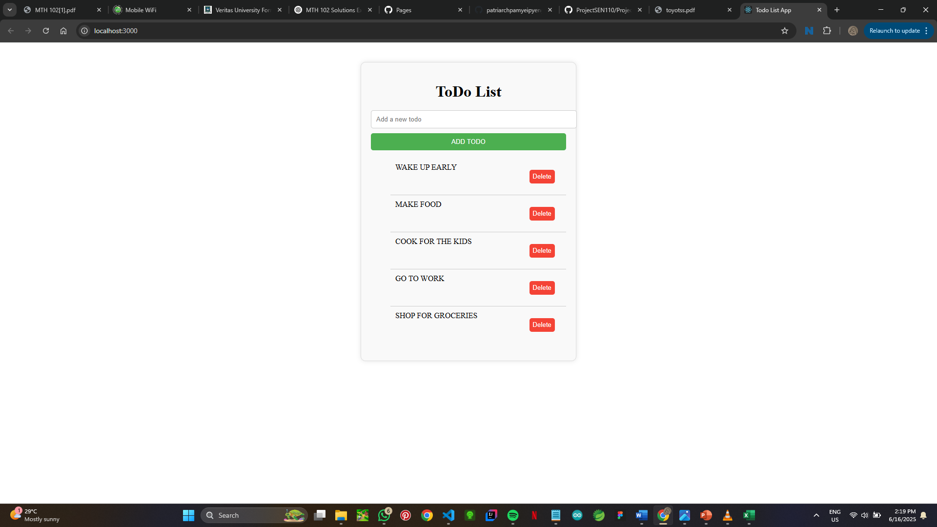
Simple Todo List App Using React Stay Organized, Boost Productivity!

Slide 2
The Problem
We all have tasks to complete, but sometimes it’s hard to keep track of them.
Forget important tasks
Feel overwhelmed by multiple tasks
Struggle to prioritize tasks

Slide 3
The Solution
Our Todo List app helps you to stay organized and focused
Easily add and manage tasks
Mark Tasks as completed
Prioritize tasks

Slide 4
Key Features
Simple and intuitive interface
Add, edit, and delete tasks
Mark tasks as completed
Responsive design

Slide 5
Benefits
Our Todo List App can help you:
Increase productivity
Reduce Stress
Stay Organized

Slide 6
Call To Action
Get Started Today!
Download our Todo List App and start staying organized!

